Slide 1
Fresh Grads – Group Project
Online Sweet Mart

Slide 2
Problem Statement
To Create an Application for Online Sweet Mart Application
Customer can login, search, buy and order the sweet item.
Admin should be able to perform below operations:
1.Customer Management
2.Product Management
3.Order Management

Slide 3
Road Map
Application will be developed in following Sprints –
Core Java +JPA with Hibernate
Spring Boot + Rest Controller + JPA with Hibernate
Angular for UI design (Front End) + Integration with previous Sprint

Slide 4
Plan
Design
Generate the skeleton as per class design provided
TDD approach
Identify test cases for each module
Write Failing Test cases
Convert the Test Cases in GREEN
Implement the case study in incremental manner

Slide 5
Modules
User Module
Customer Module
Admin Module
Category Module
SweetITem Module
SweetOrder Module
Cart Module
Product Module

Slide 6
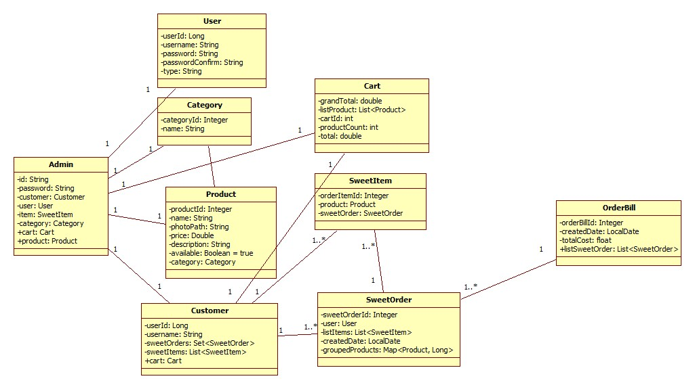
Class Design
POJO Classes:

Slide 7
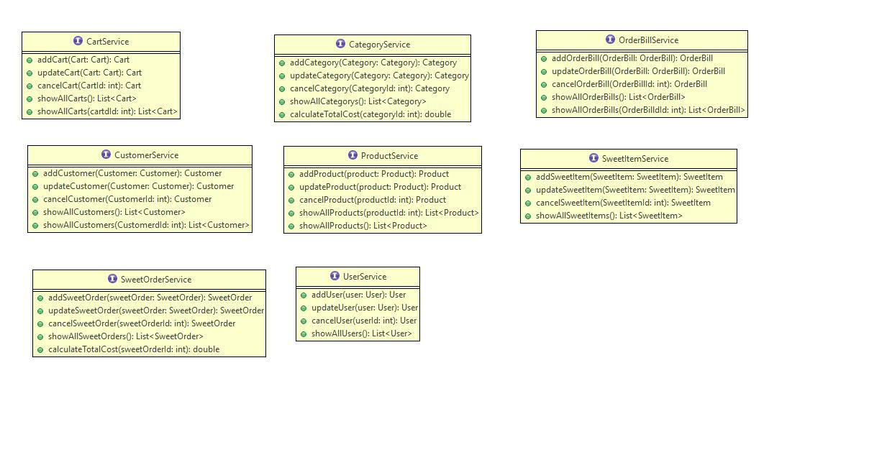
Class Design
Service Interface:

Slide 8
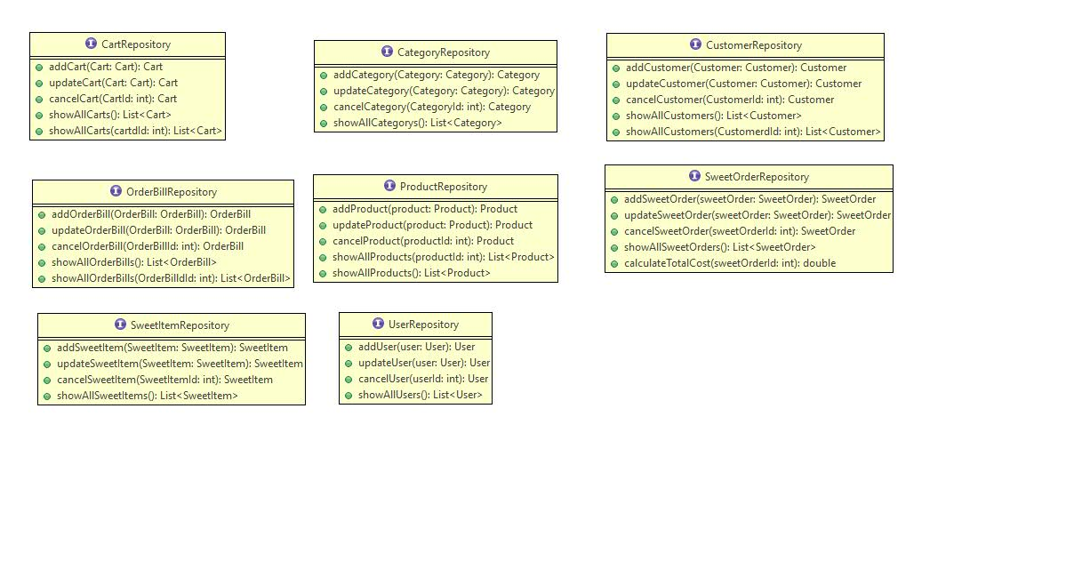
Class Design
Repository:

Slide 9




Questions

